Slide 1

Peoples Information Technology Program (PITP)
Python Programming Bootcamp - Day 3
Input, Output, and String Formatting
Atta Muhammad
attapanhyar@quest.edu.pk
+923331971110
Quaid e Awam University of Engineering, Science and Technology

Slide 2
Learning Objectives
Understand how to accept user input in Python.
Learn various ways to format output.
Explore string methods for manipulating text.
Develop programs that interact with the user.

Slide 3
Review of Previous Sessions
Day 1 Recap: Introduction to Python, installation, basic data types, and simple programs.
Day 2 Recap: Variables, data types, and arithmetic operations.

Slide 4

Input in Python
Function: input()
Allows the user to provide data during program execution.
Exercise 1: Write a program that asks for the user's age and then prints a message with the age.

Slide 5

Data Type Conversion with Input
By default, input() returns data as a string.
Converting Input:
Convert to int(), float(), or other types as needed.
Exercise 2: Write a program that asks for two numbers, converts them to integers, and prints their sum.

Slide 6
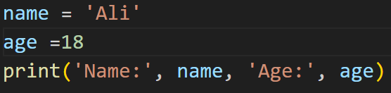
Output in Python
Using print() to display information.
Multiple arguments in print()
Exercise 3: Write a program that asks for the user's name and favourite colour, then prints them in a sentence.

Slide 7
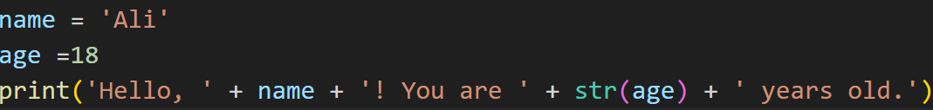
Formatting Strings with Concatenation
String concatenation using +
Limitations: Using + can get messy for complex outputs.

Slide 8
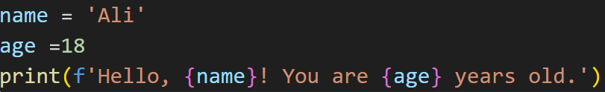
Introduction to String Formatting
Formatted Strings (f-strings):
Advantages: Cleaner and easier to read than concatenation.
Exercise 4: Modify your previous program to use f-strings.

Slide 9
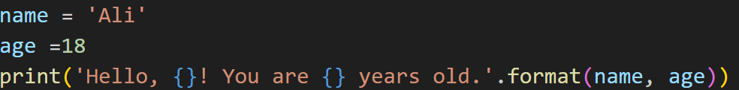
String Formatting with format()
Example:
Works similarly to f-strings but without embedding variables directly.
Exercise 5: Write a program that asks for the user's favorite hobby and prints a message using format().

Slide 10
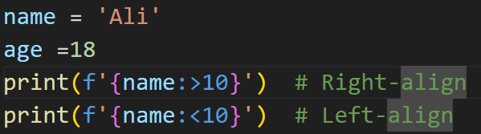
Padding and Alignment
Adding Padding: Useful when aligning text or numbers in a specific format.

Slide 11
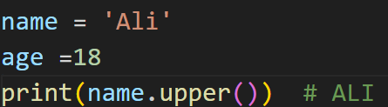
String Methods for Formatting
Common String Methods:
upper(): Converts a string to uppercase.
lower(): Converts a string to lowercase.
title(): Capitalizes the first letter of each word.
Exercise 7: Write a program that asks for a sentence and prints it in uppercase, lowercase, and title case.

Slide 12
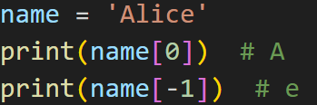
String Slicing
Accessing parts of a string:
Exercise 11: Write a program that asks for the user's full name and prints just the first name and the last name using slicing.

Slide 13
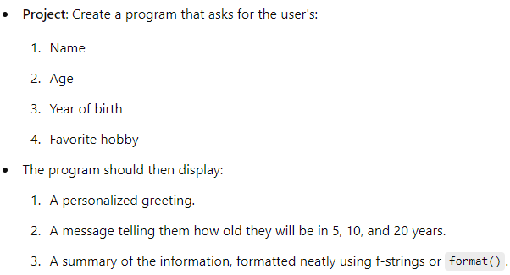
Complex Exercise

Slide 14
Wrap-Up & Q&A
Summary: Reviewed input, output, string methods, and formatting.
Share your experiences or issues with the exercises.
Any questions?

Slide 15
